Slide 1

Project
3
Team members
Faisal, Abdulaziz, Wafa, Arwa

Slide 2

01
02
03
Project objective
Data preprocessing
Model training
04
05
06
Model evaluation
Challenges and limitations
Model prediction
Overview
What we'll discuss today

Slide 3

Project Objective
Build a deep learning model that can predict the true and fake news in newspaper.

Slide 4




Data Preprocessing
LOADING THE DATA
Data Splitting
Use Stopwords
DATA CLEANING

Slide 5

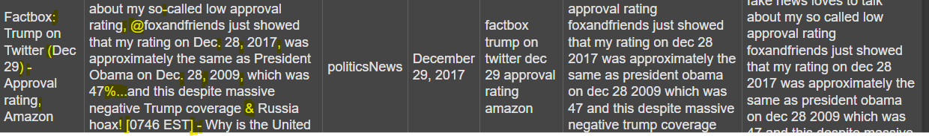
DATA CLEANING

Slide 6



Model Training
Apply TF-IDF
Train Random
Forest Model

Slide 7


Model Evaluation

Slide 8
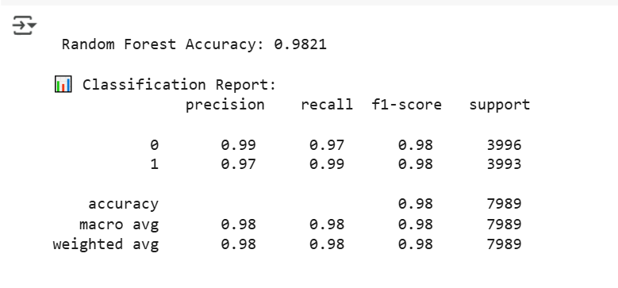

Model Evaluation

Slide 9

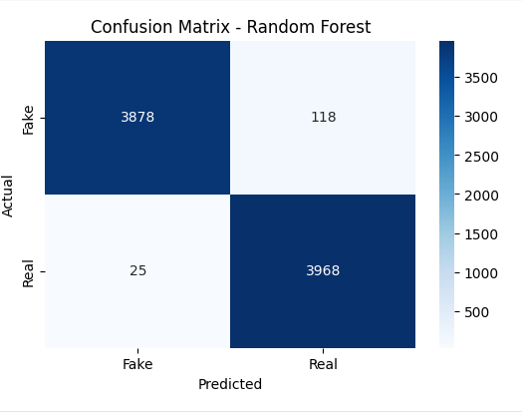

Model Evaluation

Slide 10
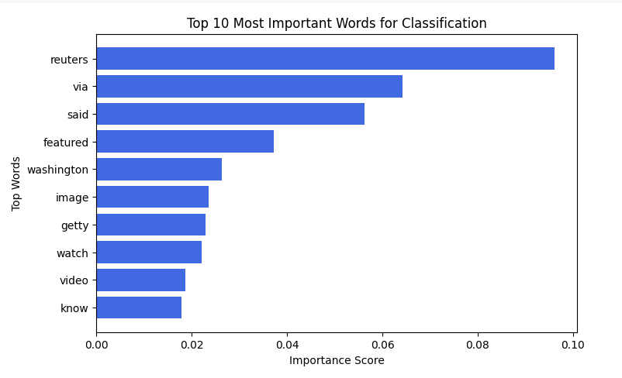
Model Evaluation

Slide 11
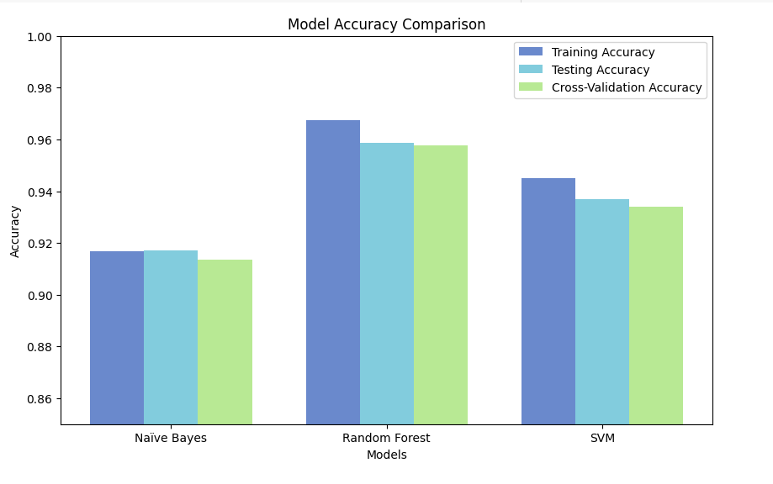
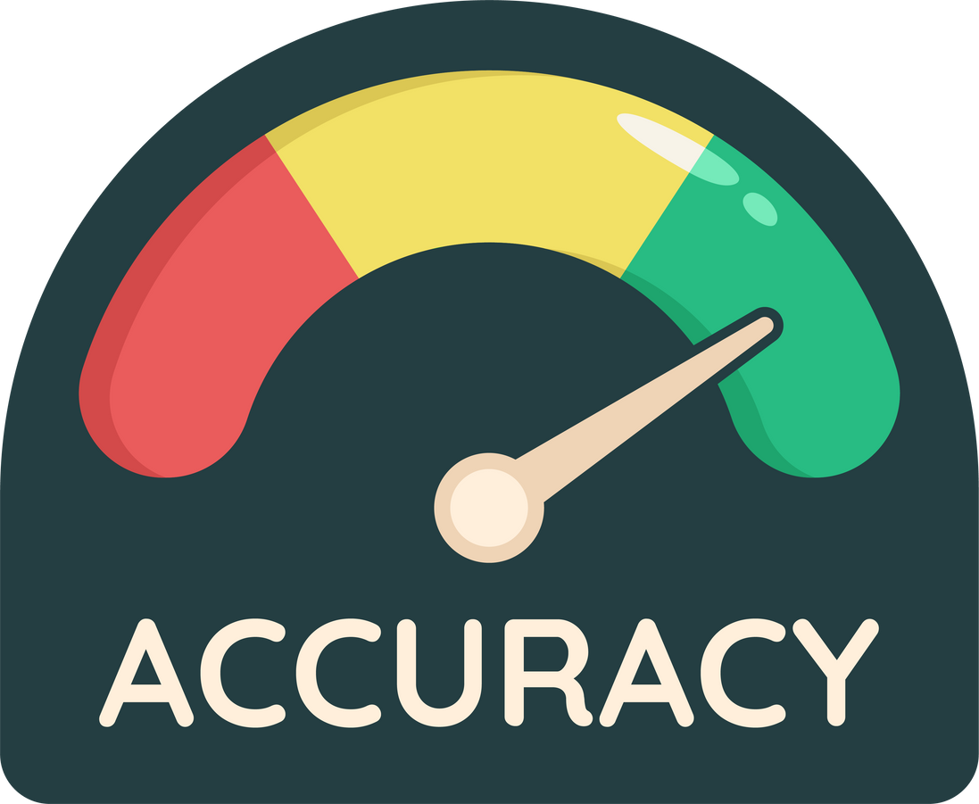
Model Evaluation

Slide 12

Challenges
and limitations

Slide 13

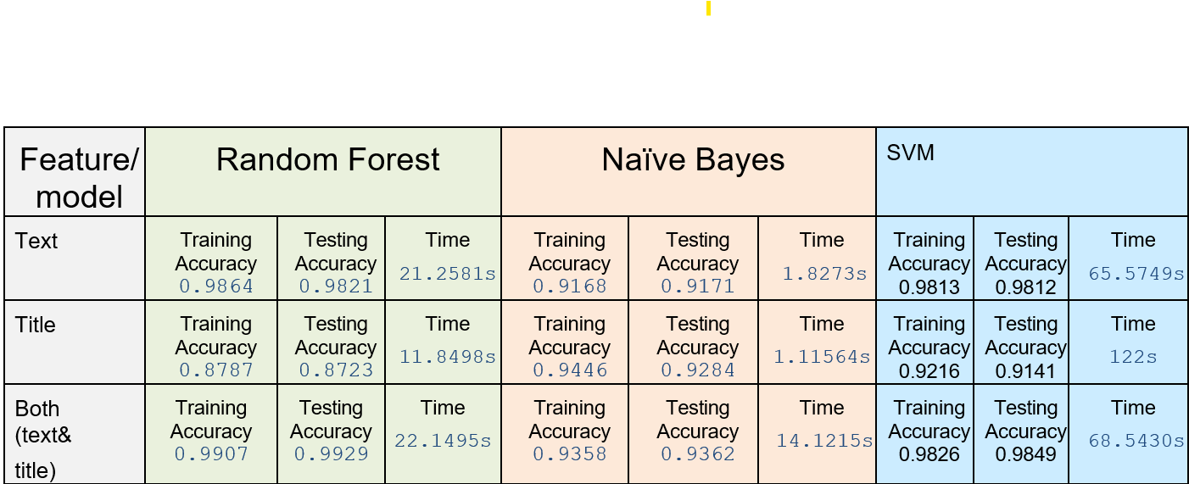
Challenges
and limitations

Slide 14


Model Prediction

Slide 15



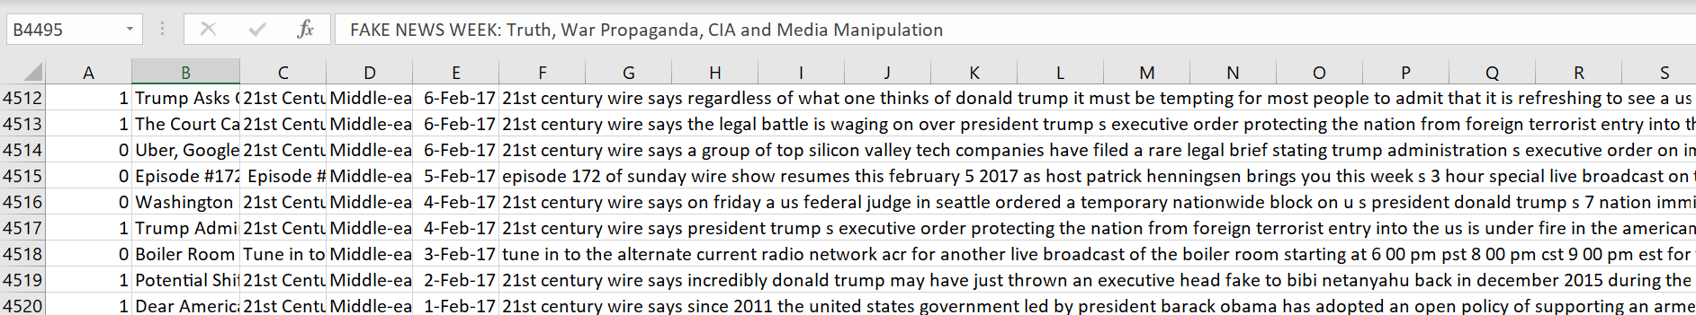
Model Prediction

Slide 16

Team contribution

Slide 17


Thank you

